Slide 1
GRAMNER CASE STUDY
SUBMISSION
BY:
Shubhi Upadhyay
Nikhil Srivastava
Lankireddy Sita rami reddy
Siddharth jain

Slide 2
Abstract
Business Objective:
the company wants to understand the driving factors (or driver variables) behind loan default, i.e. the variables which are strong indicators of default.
The company can utilize this knowledge for its portfolio and risk assessment.
Strategy: Plot charts to visually identify problems areas
Constraints:
Loans rejected by bank are not considered
Data Source:
complete loan data for all loans issued through the time period 2007 to 2011.

Slide 3
Problem solving methodology
Data understanding and Cleaning
Data Analysis
Analysis of Charged-Off Loans
Recommendations
AS-IS loading Loan in R
Analysis of raw data using univariate & bivariate analysis.
Segmentation Analysis of Charged off Loans
Analysis of key columns of loan data.
Convert Issue Date to standard format
Identify driving factors behind loan defaults
Remove unwanted columns having 0 and NA
Check for Duplicate & null values

Slide 4
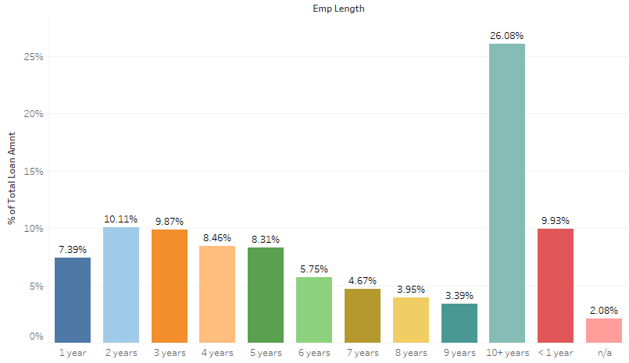
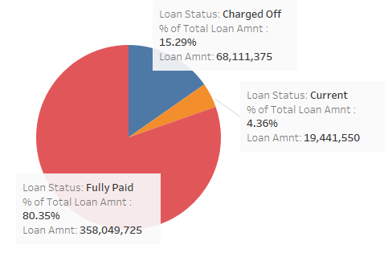
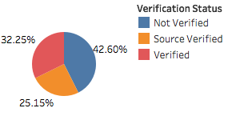
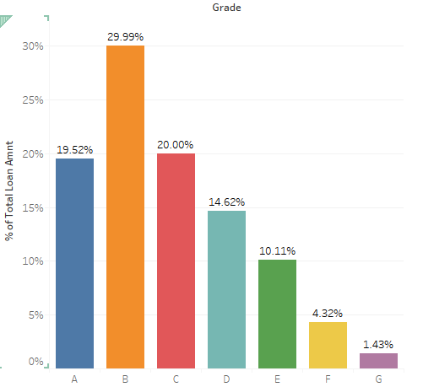
Univariate analysis on Key attributes
Loan Status
Emp Length
People with Employment length >10 yrs are getting max loans
80% loans are fully paid.
~15% are charged off
Grade
Max no. of loans fall in Grade B category
43% Loan are not verified ,while 32 are verified

Slide 5
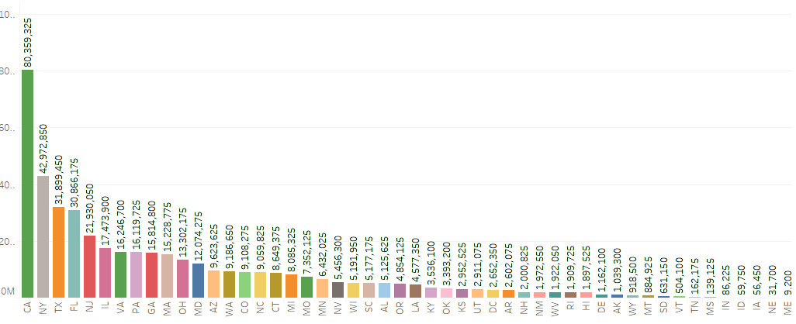
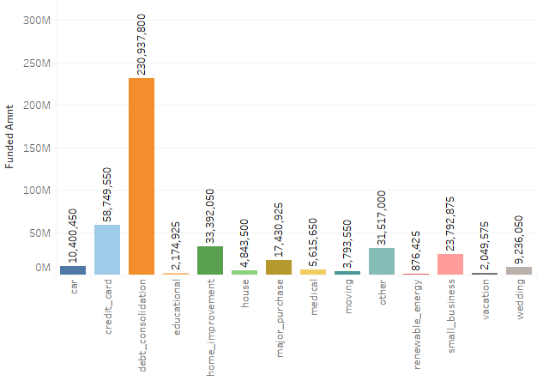
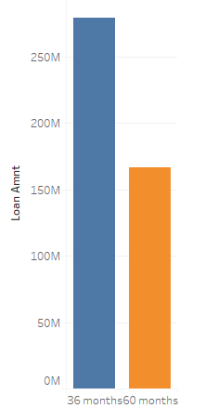
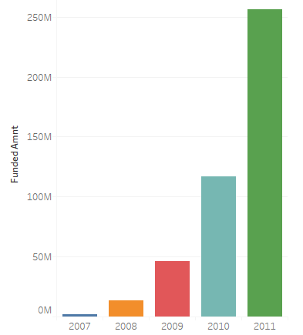
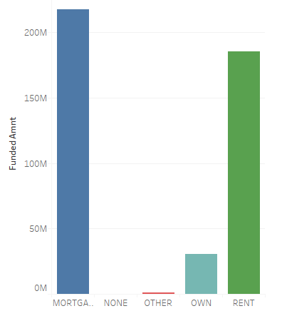
Univariate analysis on Key attributes (contd..)
States
Purpose
Top Purpose for which max loans were disbursed:
Debt Consolidation
Credit Cards
Home Improvement
Top States where max loans were disbursed:
CA
NY
TX
FL
NJ
Term
Year of Issue
Home Ownership
There is year on year increase in loan disbursement with 2011 have the most loans sanctioned
More loan are taken for 36 months Duration
People with Rented and Mortgage Homes take more loans than those having own homes

Slide 6
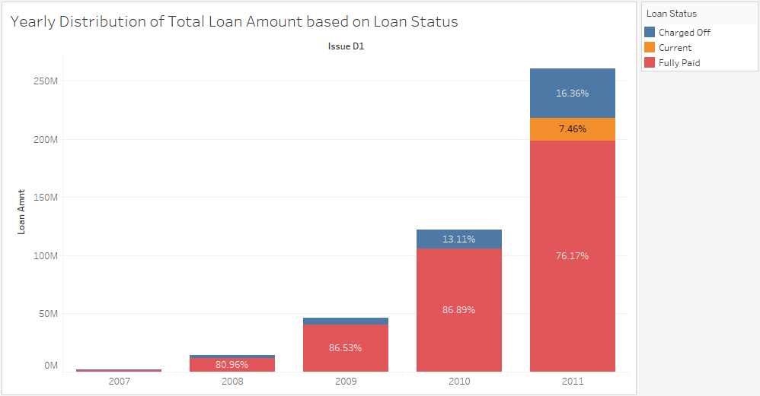
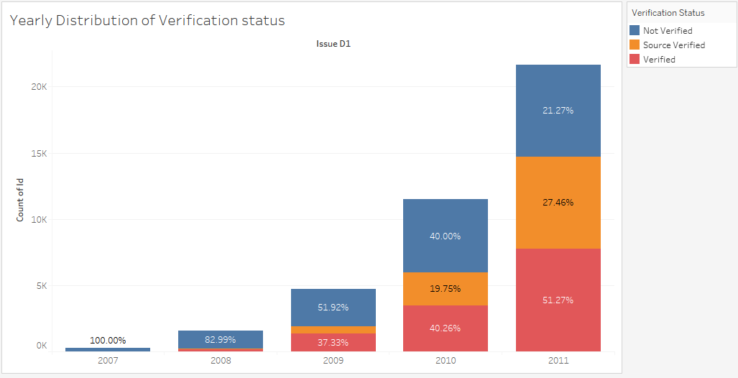
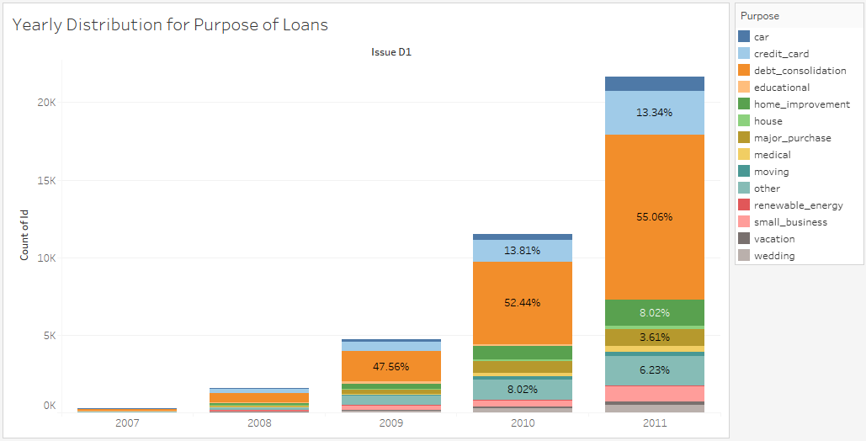
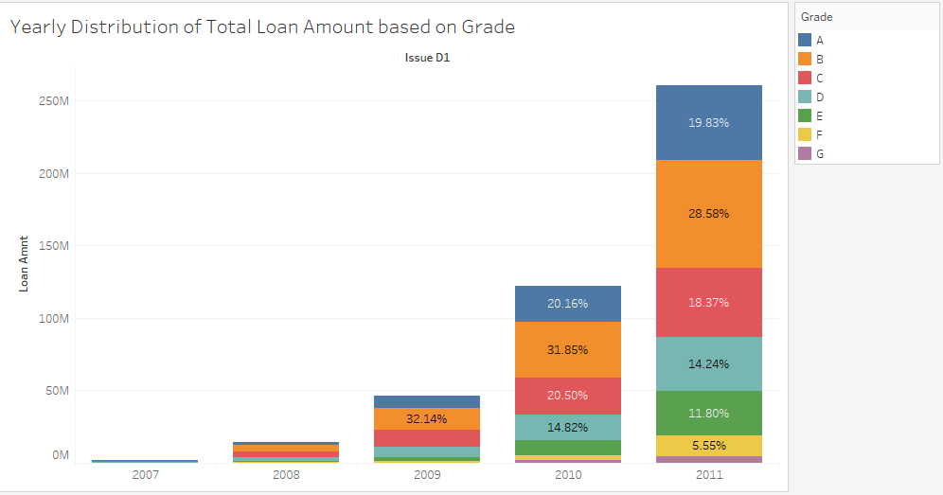
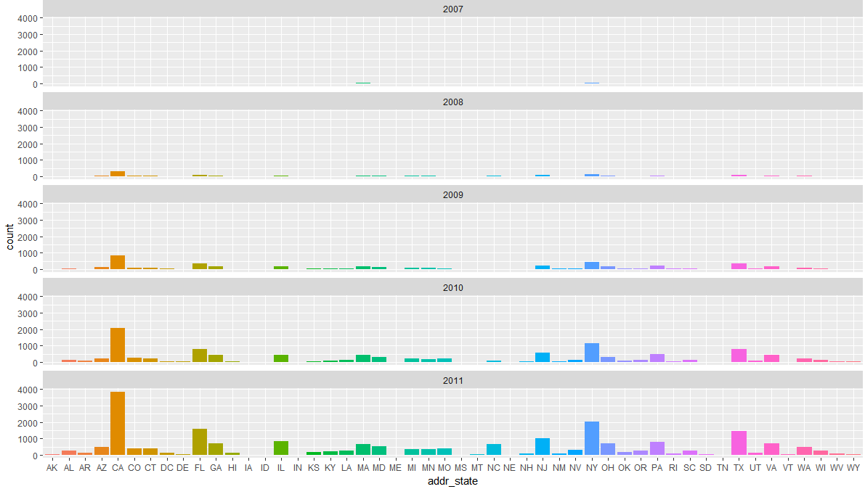
Bivariate analysis on Key attributes
Variable: Year in which Loans were sanctioned
Since most loans were disbursed in 2011, most bivariate analysis shows higher count/percentage in 2011.
The trends identified in univariate analysis are also visible in bivariate analysis using issued year.
On Loan Status:
  A good percentage of loan are Fully Paid year on year.
  The count and percentage of Charged-Off increases as we move from 2007 to 2011
On Verification Status:
  More loans are getting Verified year on year while not-verified %age is decreasing.
On Purpose:
  Top categories every year: Debt consolidation, credit card, home improvement
On Grade:
  Max loans sanctioned in Grade B year on year.
On State:
  Max loans sanctioned to States: CA, NY, TX, FL , NJ

Slide 7
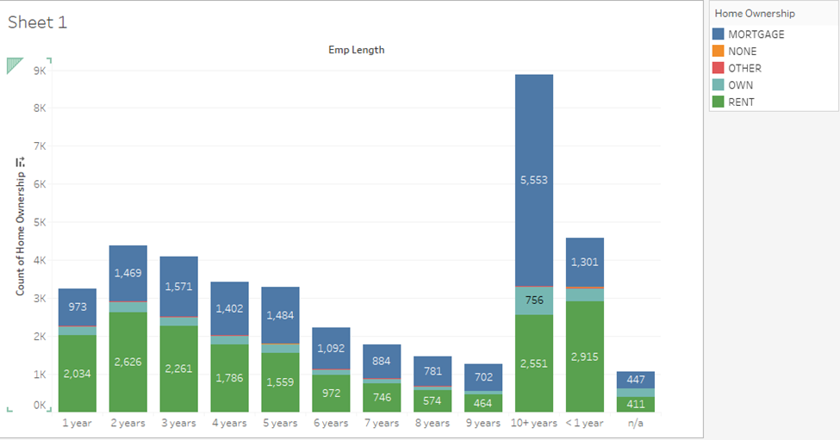
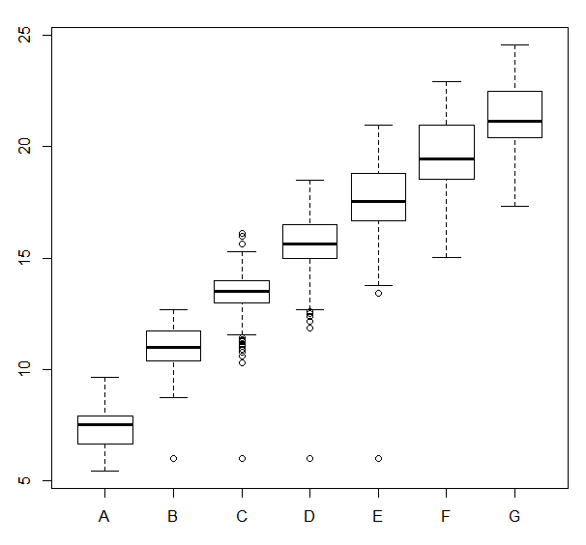
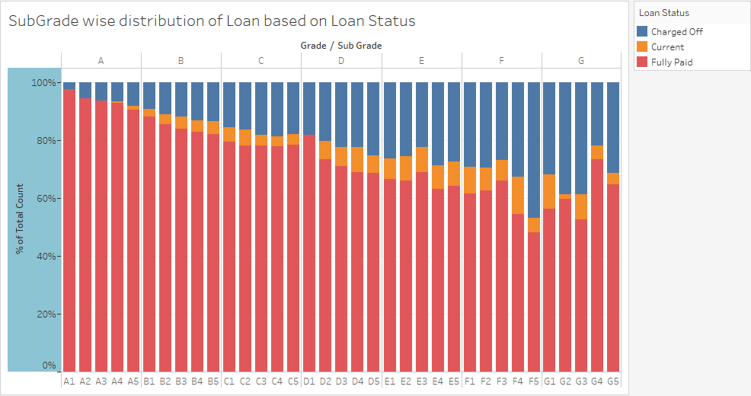
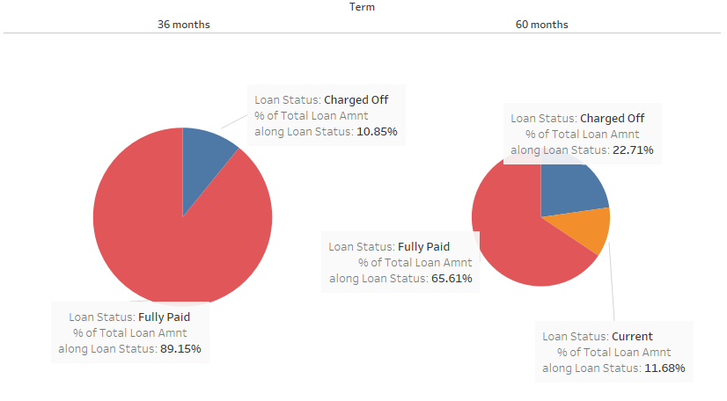
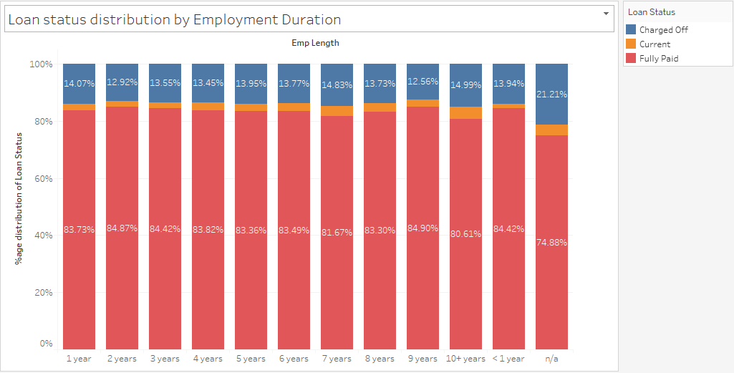
Bivariate analysis on Key attributes (contd..)

Slide 8
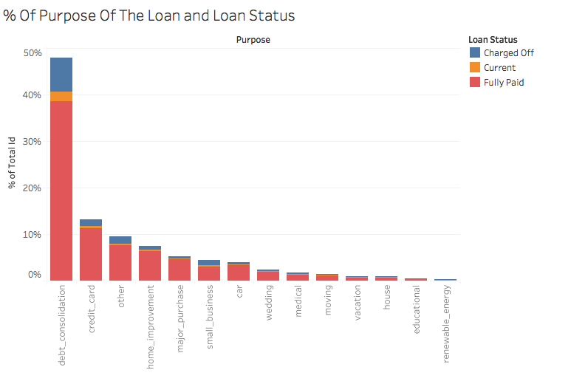
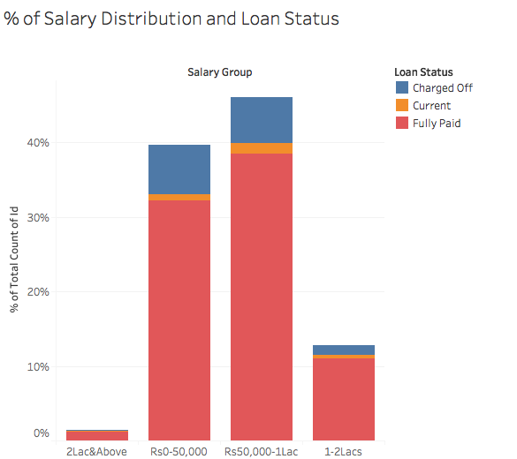
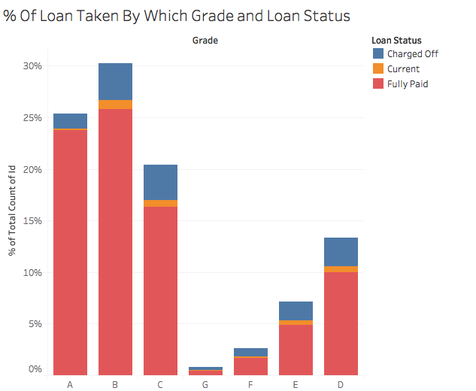
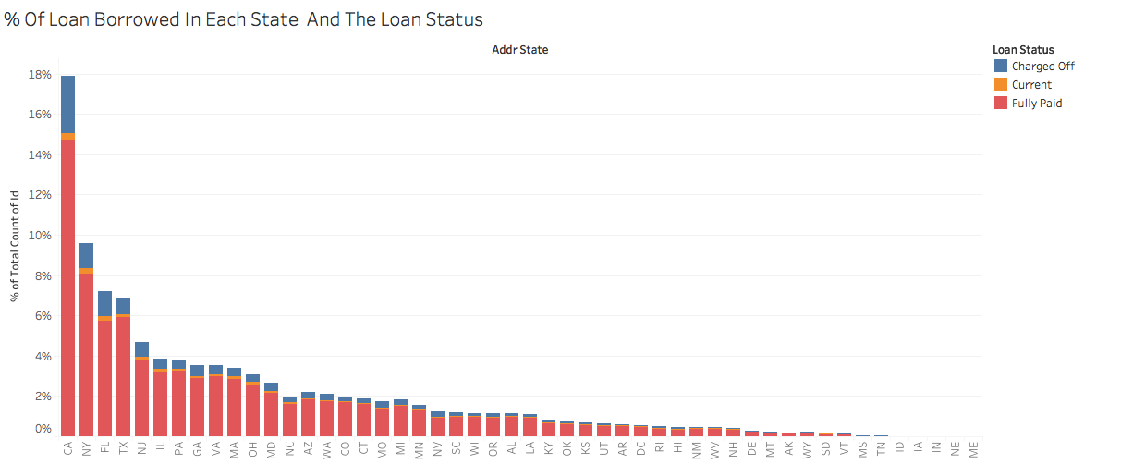
Bivariate analysis on Key attributes
The top most 5 factors where the % of charged off customer is highest are mentioned below:
The trends identified in bivariate analysis is also visible in segmented analysis.
On Term:
  A good percentage of loans which were charged off lie in 36 months term.
  The same thing is visible in segmented analysis as well
On Purpose:
  Top categories : Debt consolidation, credit card, home improvement
On Salary:
  People with salary between 0 to 1 Lac have high chances of getting defaulted.
On Grade:
  Max loans sanctioned in Grade B.
On State:
  Max loans sanctioned to States: CA, NY, FL, TX , NJ

Slide 9
Bivariate analysis on Key attributes (contd..)
Salary Distribution & Loan Status
People with salary between 0 – 50,000 are the one who take most loan and the one who get defaulted.
Interest Rate & Grade
As the Grades increases, the interest rates increase.
Subgrade & Loan Status
Grade A and its subgrades are best categories in terms of payments and has least count of loans that had been charged-off
Term & Loan Status
36 Months:- Most loan were defaulted in 36 months term.
Employment length & Loan Status
80-85% of the Total loans were Fully Paid across all employment durations.
There is a increase in count of loans that were charged off from A to G (barring some exception)
Grade F and SubGrade F5 has the worst rate with 47% loans marked as "Charged-Off"
12-15% of total loans were Charged-Off across all employment durations.
The variation in % distribution is highest in 60 term but if we see overall variation 36 month tops the list.

Slide 10
Segmented Analysis on “Charged-off” loans
Problem Statement
Understanding Charged off Loans across various variables.
Assumption
Columns having NAs and 0 were removed
Conclusion
Key Variables:
Identify the key variables that impact bad loans
Criteria
Only loans that were marked as “Charged-Off” would be considered
Purpose, State, Grade, Home ownership
Amount of loan pending for such loans used for analysis

Slide 11
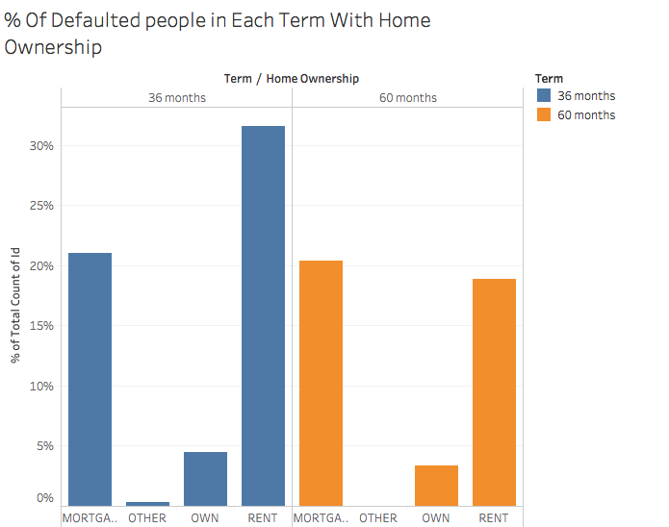
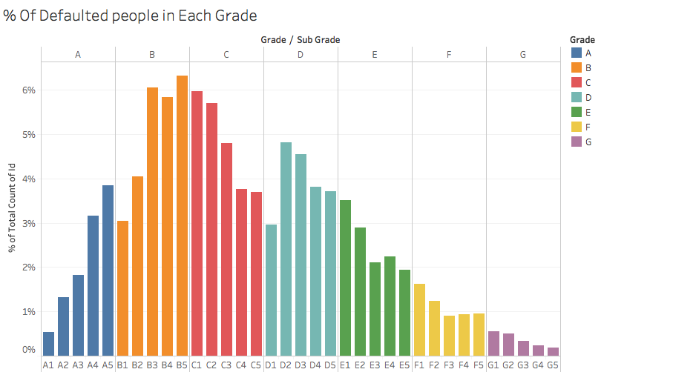
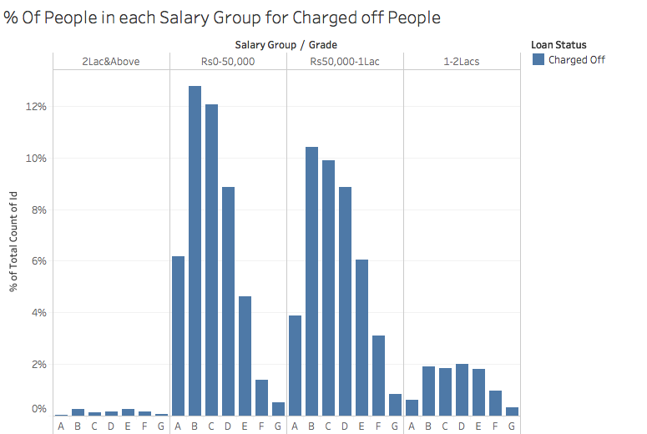
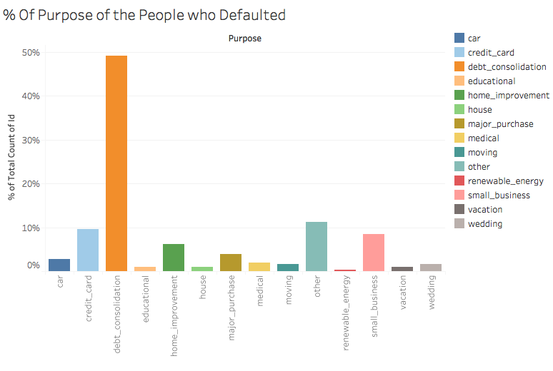
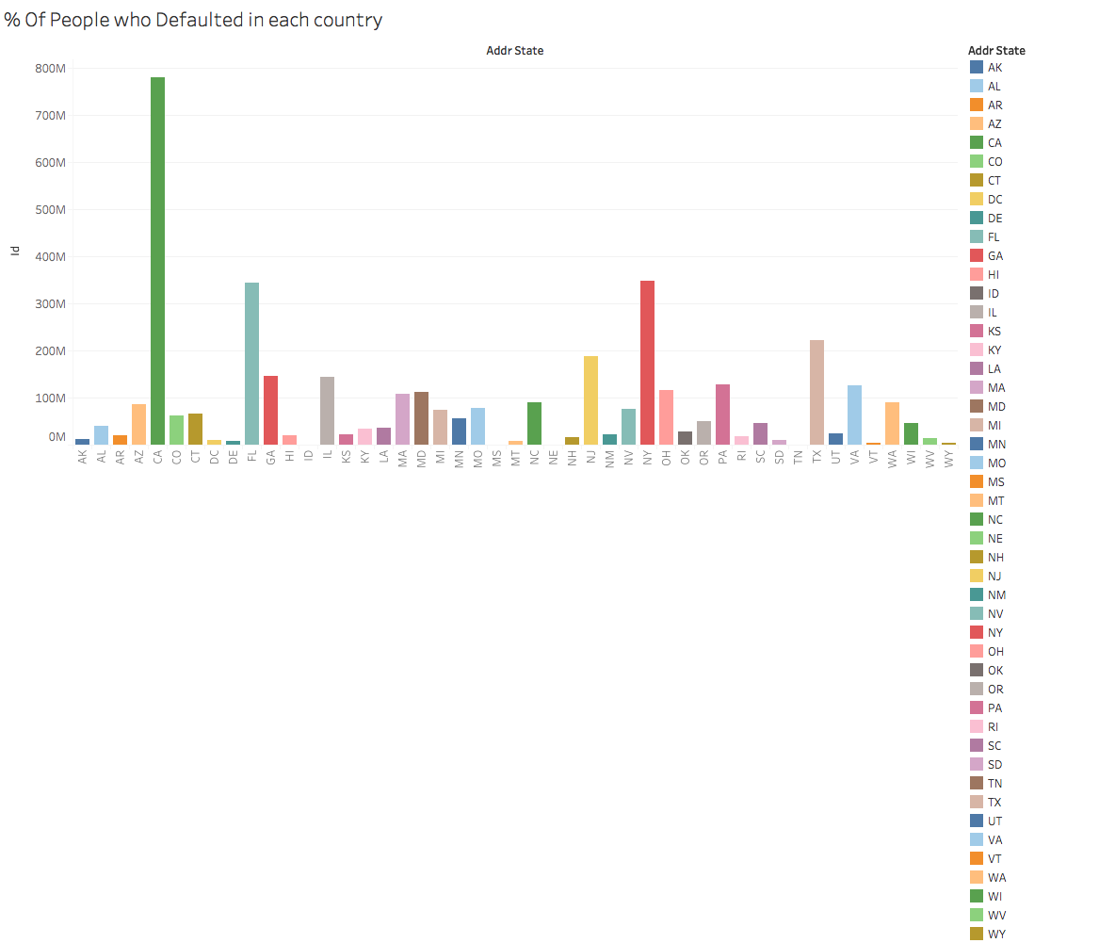
Segmented Analysis on “Charged-off” loans
If we do similar analysis only on people who charged off the loan, we can see that again the below given factors tops the list.
On Term:
  Again loan with 36 term top the list.
  People who stay on rent or taken mortgage take most loan here
On Purpose:
  Top categories Debt consolidation, credit card, home improvement here also
On Salary:
  People with salary between 0 to 1 Lac have high chances of getting defaulted.
On Grade:
  Max loans sanctioned in Grade B with subgrade B5 , B3 and B4 topping the list.
On State:
  Max loans sanctioned to States: CA, NY, FL, TX , NJ

Slide 12
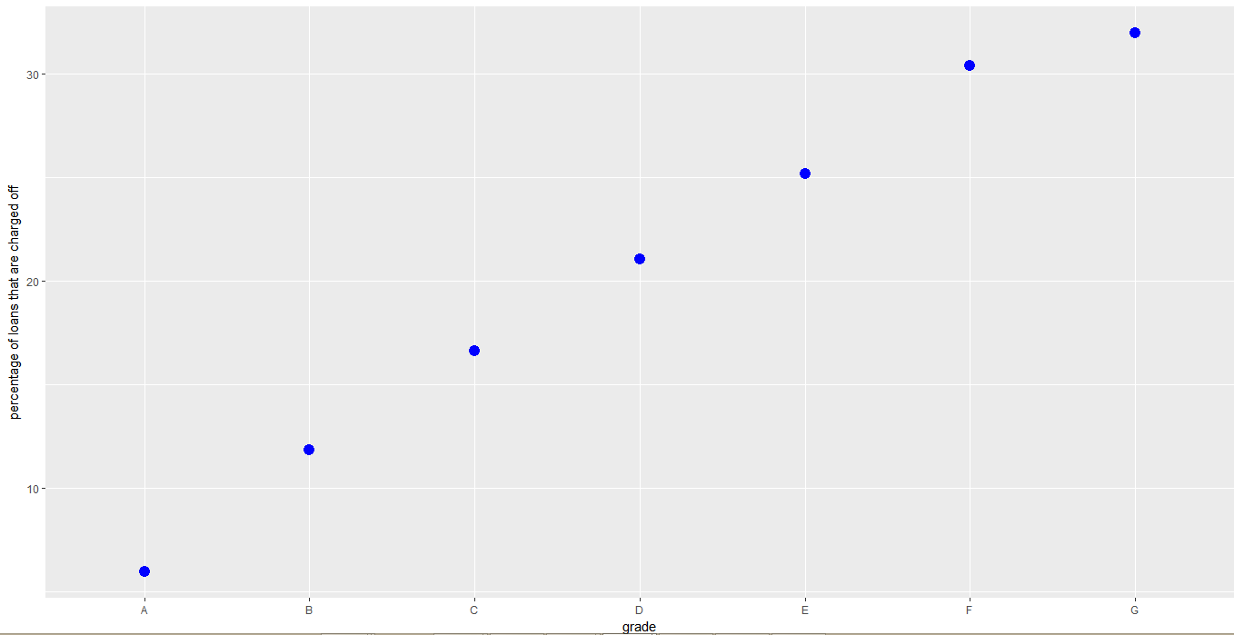
From the below plot we conclude that as grade moves from A to G the percentage of defaulters increases, so we conclude that as grade moves towards G the chances of defaulters increases.

Slide 13
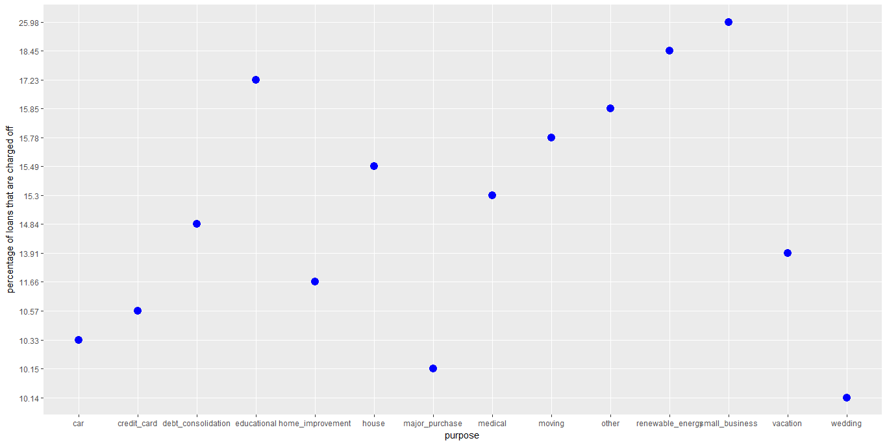
From the below plot we conclude that there are more percentage of defaulters in small business fallowed by renewable energy. So there are more chances of defaulters in these groups

Slide 14
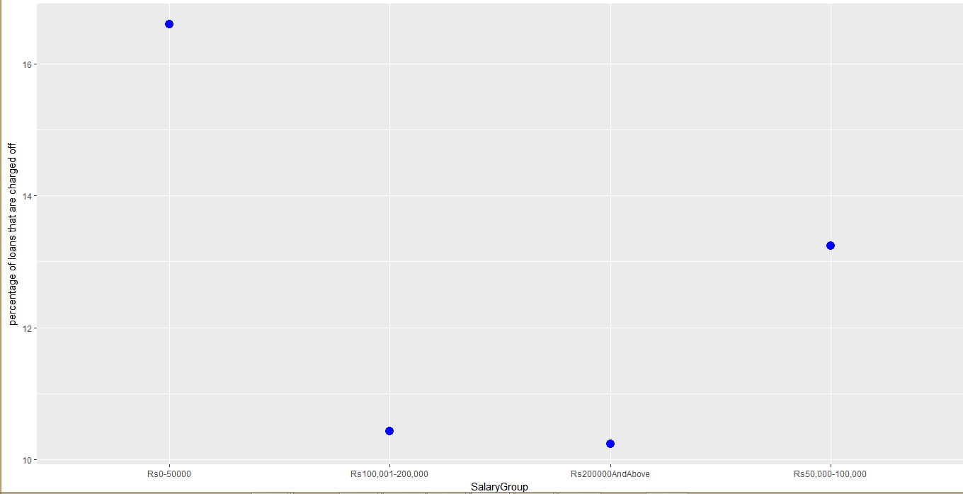
From the below plot we conclude that the percentage of defaulters is high in salary groups less than 50000 fallowed by salary group of 50000 – 100000.
So giving loans for these two groups will lead to more chances for defaulters.

Slide 15
Overall Analysis
    From the above analysis we can conclude that , the factors that will effect the loan status are:
      Grade
      Purpose
      Annual income
    As the grade increases interest rate increases.
    80% of loans are fully paid.
    People with greater then 10+ years employee length are getting more loans.
    Maximum number of loans fall under grade B.
    CA,NY,TX,FL,NJ are the top 5 states where maximum loans are disbursed.
    Debit consolidation, credit cards, Home improvement are the top purpose for which loan is disbursed.

Slide 16
Overall Analysis
Year of Issue: Loan disbursement is increasing every year from 2007 to 2011.
Home Ownership: People with rented and mortgage home are taking more loans.
Grade: As the grade increase from A to G the probability of defaulters increases.
Purpose: Regarding purpose of loan small business and renewable energy have more probability for defaulters.
Income: Annual income with less than 1lakh have more chances for default.

Slide 17
Recommendations
Since Grade E,F,G have more probability for defaulters, bank can reduce to give loans for such people who are in those grades.
As probability of defaulters is more for the purpose of small business, please take necessary actions while disbursing loans to them.
As probability of defaulters is more for low annual income people, please reduce to give loans for such people.

Slide 18


